Slide 1
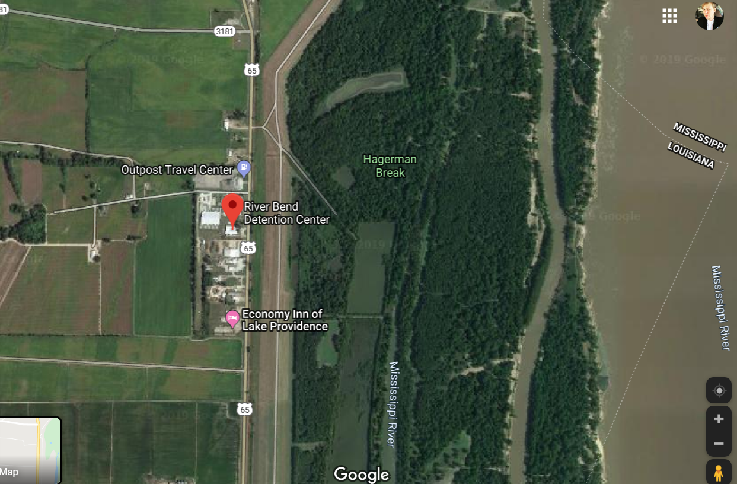
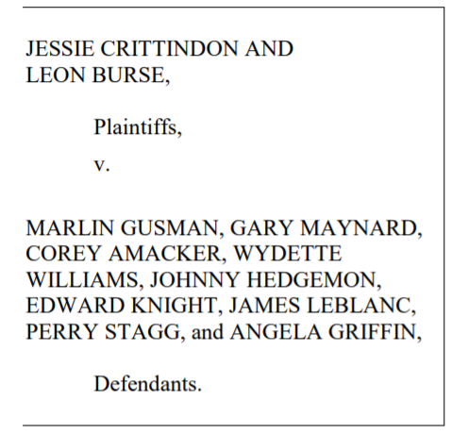
East Carroll Riverbend Detention Center
Men, women and juvenile inmates – as high as 1,850? though numbers are unclear
Pre-trial convictions with 40% of facilities dedicated to DOC sentences
Pending litigation regarding holding inmates for months past release dates, holding juveniles, and other civil rights claims
Constructed in 1995 and checkered with
confused history moving between public and
private management
Major obstacles to transparency
Located in community experiencing extraordinary historical poverty and history of violence and oppression.

