Slide 1
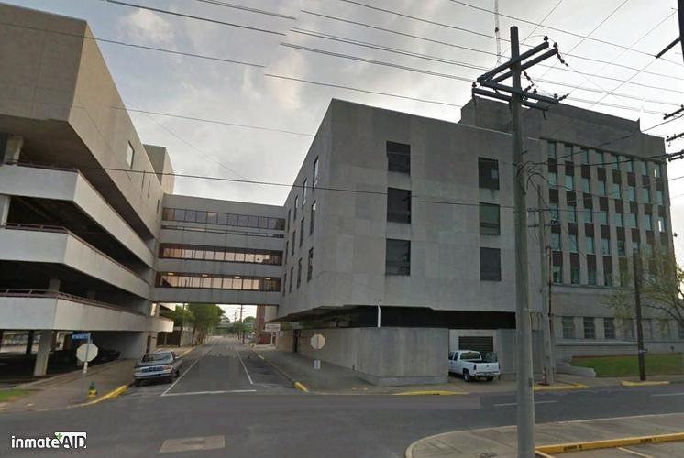
Rapides Parish Detention Center I
701 Murray St #302, Alexandria, LA 71301
Overview: Rapides Parish Sheriff’s Office Correction Division is responsible for 1,070 offenders. Rapides Parish Detention Center I has the capacity to house 328 offenders.
Staff:
1. Sherriff: William Earl Hilton → Mark Wood
2. Warden: Matt Dauzat
3. Assistant Warden: Gerald Carmouche
4. Chief Admin. Officer: Debbie McBeth
Purpose of Facility:
1) It serves as an intake facility.
2) It provides housing for “Pre-trial detainees, Parish Prisoners, Department of Corrections Offenders, and offenders serving time for municipalities throughout Rapides parish.”
Financial Report (2018):
- Sheriff's Salary: $160,000
- Rapides Parish Sheriff’s Office overall Budget: $44 Million
- Cost per inmate: $35 a day
Data: Deaths in custody from 2014-2019: 5
1) Offender ingested drugs prior to arrest
2) Cancer
3) Ischemic enteritis due to effects of acute
Methane
4) Asphyxia secondary to hanging
5) Unknown Results Pending
Current Population: 220 males and 52 females
Race/Ethnicity: American Indian (1), Black (141), Unknown (1) Arabic/Middle Eastern (1), White (128).

