Slide 1
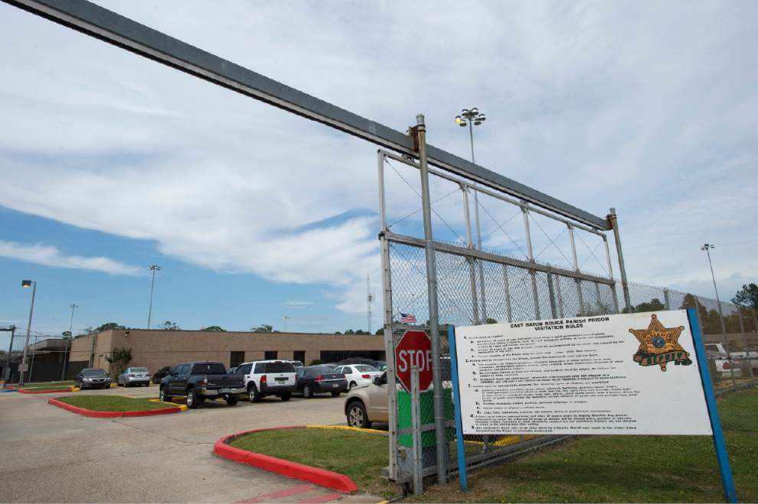
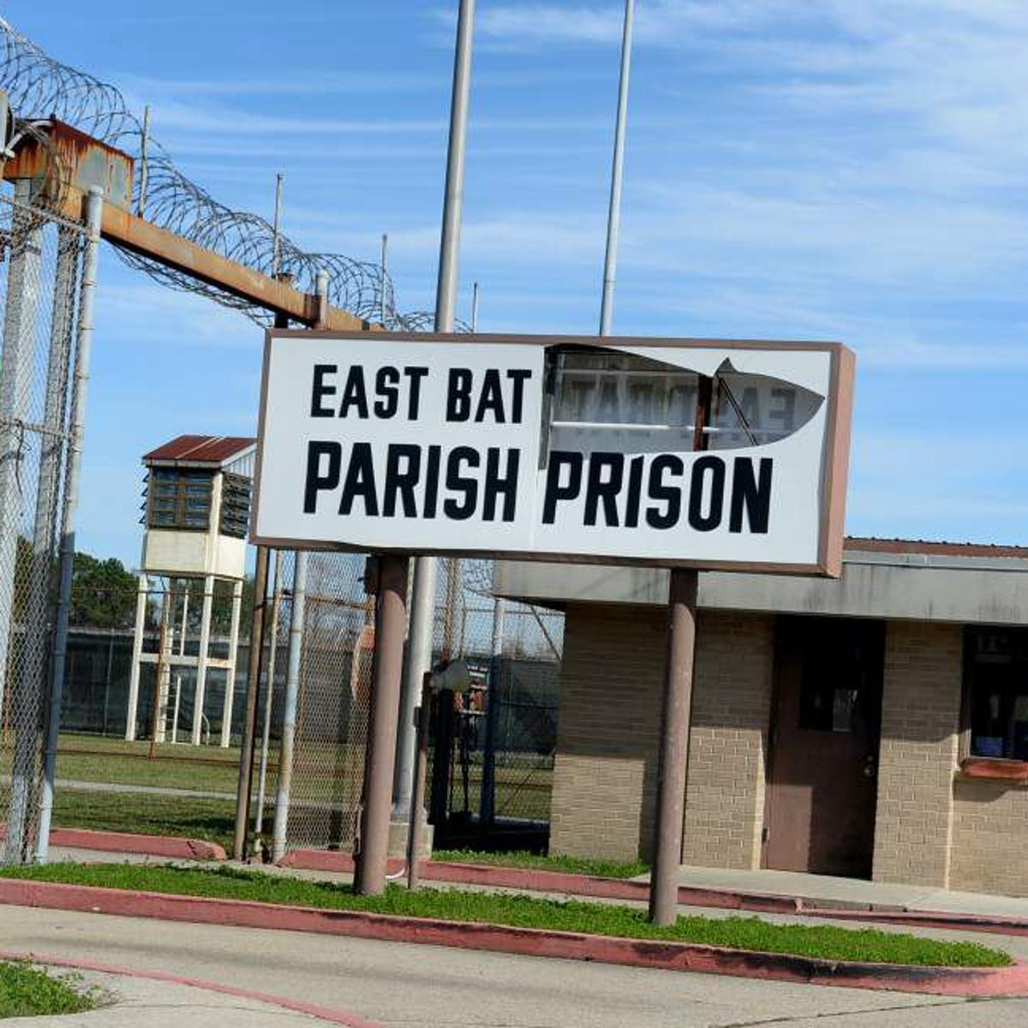
East Baton Rouge Parish Prison
& Transitional Work Release Program
2567 General Isaac Smith Avenue, Baton Rouge, LA 70807
First contact: September 6, 2019
Final response: November 2, 2019
Prison Capacity: 1550
Inmates Booked:
over 1600
Total bookings per year: 12-15,000
381 per 100,000 people in East Baton Rouge Parish incarcerated.
Deaths in Custody since 2014: 29
Requested budget: $10,412,200
Proposed budget: $8,876,060
Sheriff Sid J. Gautreaux, III
Warden Dennis Grimes
Assistant Warden Catherine Fontenot
Captain Johnny Scott
EBRPP deaths are 2.5 x the national average.
Bailey v. E. Baton Rouge Parish Prison (Dental)
Burns v. E. Baton Rouge Parish Prison Emergency Med. Servs. (Dental)
Dolores Zadikian (sister of deceased Jonathan Fano - 27)

