Slide 1
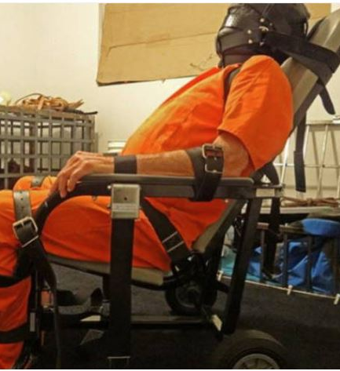
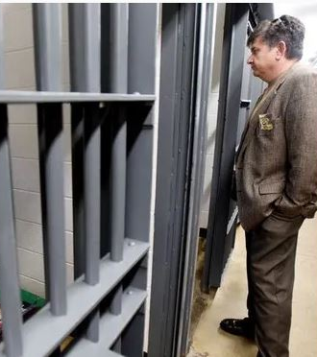
David Wade Correctional Center
1,174 inmate capacity
Warden Jerry Goodwin
Operational since 1980
Accredited by American Correctional Association Commission on Accreditation in 1992
Average 99% capacity during all months of 2017
368 beds reserved for “Restrictive Housing”
“Restrictive Housing” inmates are allowed one hour of exercise five days per week and one 10 minute phone call per month
History of clandestine, combative behavior against third party oversight
Over 200 Lawsuits against facility during lifetime
Settled lawsuit over negligent death of inmate tied to chair for 3.5 days
Blocked Advocacy Center investigators after death of inmate Robert Baltimore
Multiple allegations of inhumane inmate treatment
Almost half of inmate population held in “maximum custody”
Allegations of coercing inmates to withdraw from litigation in exchange for removal from solitary
Allegations of treating mental health issues with tying to chairs as treatment

