Slide 1
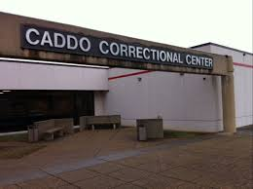
Caddo Correctional Center
Location: Shreveport, LA (pop. 188,987), Caddo Parish (pop. 246,034)
Size: 1500 beds, 311,000 sq. ft.
Opened 1989
Total deaths, 2014-2019: 5
Demographics: 91% male, 58% black, 26% ages 25-31, 21% ages 32-38
Transparency
-website with inmate information
-parish government hearings and minutes posted online
-timely response to public records request but not 100% transparent, high ”processing fees” for documents
Sheriff Steve Prator
Oversight
-only oversight from La. Dept. of Public Safety and Corrections
-no national accreditations
-parish independent audits and sparing Louisiana Legislative Auditor
-Assumed office 2000
-First Republican sheriff since Reconstruction era
-Spoke out against Louisiana criminal justice reforms. Received nationwide criticism over remarks that evoked slavery.
Funding and Improvements
-2020 Caddo parish projected revenue: 68,496,069
-2020 CCC budget: $3,757,949
-recent overhaul of maximum security door locks and fire alarm system
Cases and Complaints
-pro se complaints alleging due process violations (beatings) and overcrowding, unsanitary conditions
-2018 gender discrimination lawsuit filed by employee
-nationwide criticism by civil rights leaders over Sheriff Prator’s racist remarks

