Slide 1
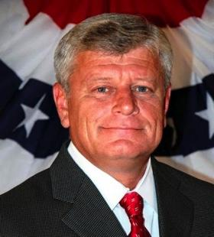
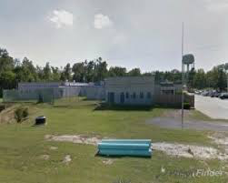
Avoyelles Marksville Detention Center
The Avoyelles Parish Marksville Detention Center is located in the city and county of Marksville, Louisiana is a medium to maximum-security facility that houses a daily average of 300 inmates and employs 75 staff members.
To place a public records request contact the Avoyelles Parish Sheriff’s Office Crime Investigations Unit. Rebecca Mayeux is the deputy of the unit.
Direct line (318)619-3980
Fax Number (318) 253-0943
Faxing the PRA is preferred
I received over 400 pages of documents and 6 DVDS
Avoyelles Marksville Detention Center is located at 675 Government Street Marksville, LA 71351. You can find their website at https://apso.website The Sheriff of Avoyelles Parish is Doug Anderson. Anderson who is pictured above has been the sheriff since July 1, 2018. David Brown is the Warden of the Marksville Detention Center. (318) 253-4000 ext. 3037 dbrown@avoyellesso.org
The budget and financial audit is located on the Legislative Audit website The total operations and maintenance for the 2017 fiscal year was $3,439, 228. The operations and maintenance includes jail expenses, supplies, telephone expenses, utilities, repairs, criminal investigations, prisoner feeding, office supplies, and bank charges and fees. The total expenditures $10,811, 652.
A total of six people have died between 2014 through 2019 while in Avoyelles Marksville Detention Center’s Custody. Many of the inmates who died in the facility were not there longer than a year. Five of the inmates were black and one white. Most of these individuals had pre-existing medical conditions before entering the facility.

