Slide 1
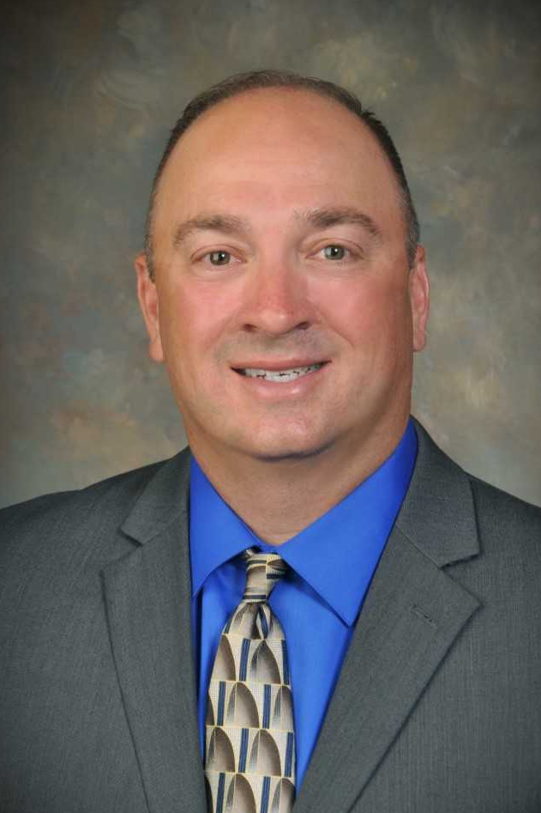
Mission Statement
It is the mission of the Acadia Parish Sheriff's Office to provide responsible, effective and efficient law enforcement services with integrity and fairness to all citizens of Acadia Parish. It is also the mission of this Office to be fiscally responsible, to keep its citizens abreast of matters affecting their safety, cooperating with the media, continuing education of Deputies, implementation of modern technology, and cooperation with local, state and federal agencies in matters of mutual interest.
Contact Us
1037 Capitol Ave.
Crowley, LA 70526
p: (337) 788-8735
w: www.apso.org
Acadia Parish Jail
Warden Laura Benoit
p: 337-788-8786
Capacity: 190 Beds
Minimum Security Facility
Male and Female inmates awaiting trial, sentencing and sentenced inmates
Visitation Times: Monday-Friday 9am to 6pm
New Inmate Video Visitation Available!
Deposit commissary and phone deposits instantly with the JailFunds app! Or by Phone, Online, Walk-in Retail or Moneygram
Total inmate deaths from 2014-2019: 4
About the Sheriff
Sheriff K.P. Gibson
p: 337-788-8701
e: kp@apso.org
28 years in Law Enforcement.
Serving Acadia Parish since 2015.
Public Record Requests
To make a Public Record Request contact the Compliance Unit:
Compliance Lieutenant Bart Habetz
p: 337-788-8788
e: bart.habetz@apso.org

